Slide 1

JavaScript Applications
Course Overview
SoftUni Team
Technical Trainers
Software University
http://softuni.bg

Slide 2
Table of Content
Introduction
Training & Team
Course Objectives
Course Organization

Slide 3
Have a Question?
sli.do
#JS-ADVANCED

Slide 4












SoftUni Diamond Partners

Slide 5




SoftUni Organizational Partners

Slide 6

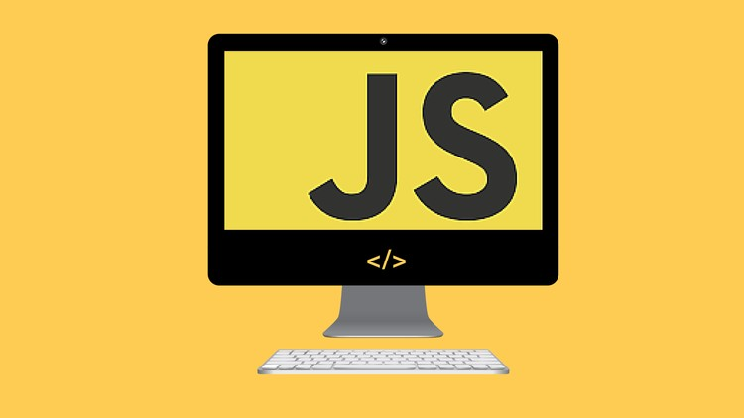
JS Applications
Course Objectives & Program

Slide 7

What are we going to learn?
This
Object Composition
Prototypes and Inheritance
REST Services and AJAX - HTTP, REST and RESTful Services, AJAX and Fetch API
Asynchronous Programming - Promises, Async/Await

Slide 8
What are we going to learn? (2)
Remote Databases - Firebase and Kinvey
Routing and Architecture - Routing Concepts and Navigation using Sammy.js
Templating - Templating Concepts, Template Engines, Handlebars Overview
Creating Single-Page-Application (SPA)
Design Patterns and Best Practices
Webpack - Introduction and Basic Builds

Slide 9

Trainers and Team

Slide 10
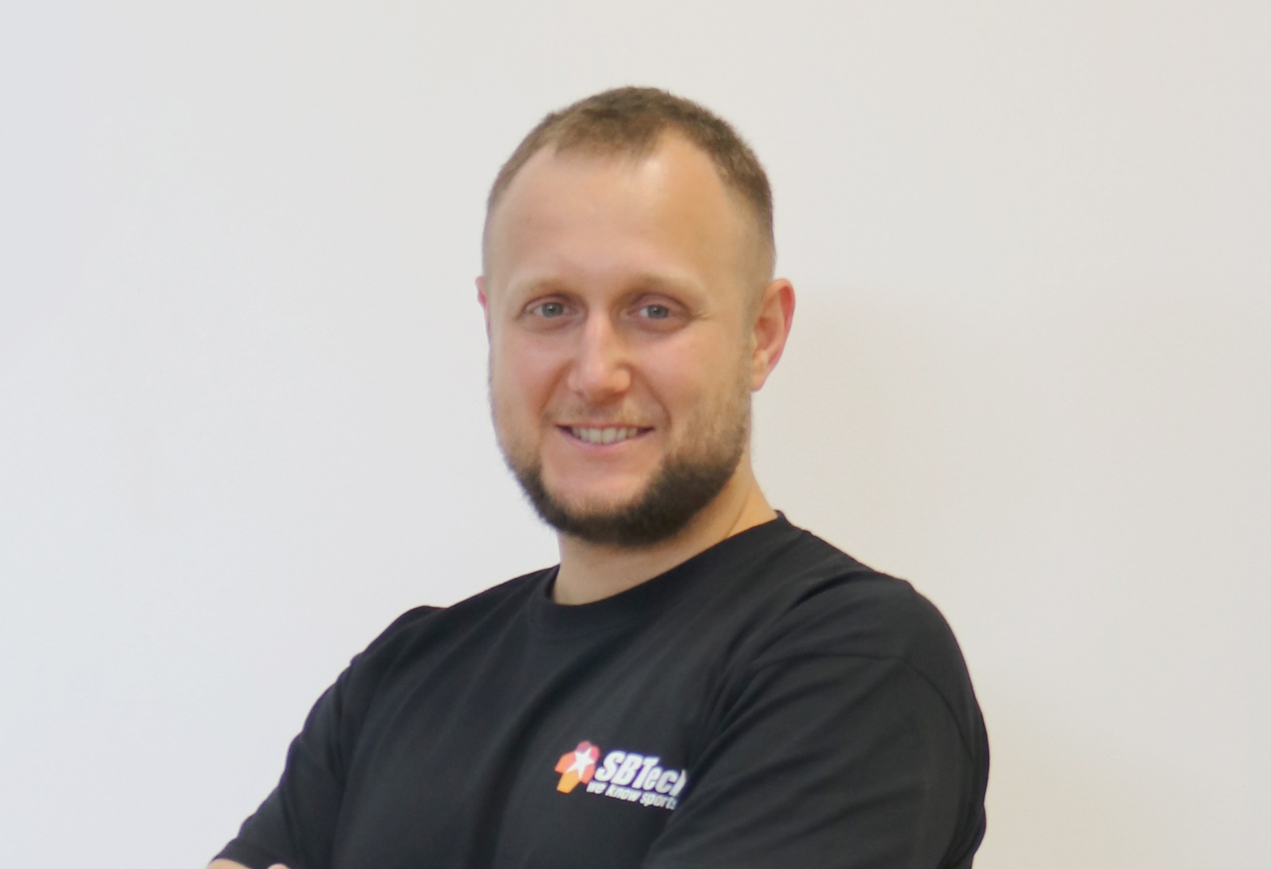
Martin Chaov
Technical Lead and Software Architect @ SBTech
Specialist in client software and JavaScript programming
His main task is to maintain and develop the SBTech end-user application architecture
This includes responsive web applications, PWAs, native apps and more

Slide 11
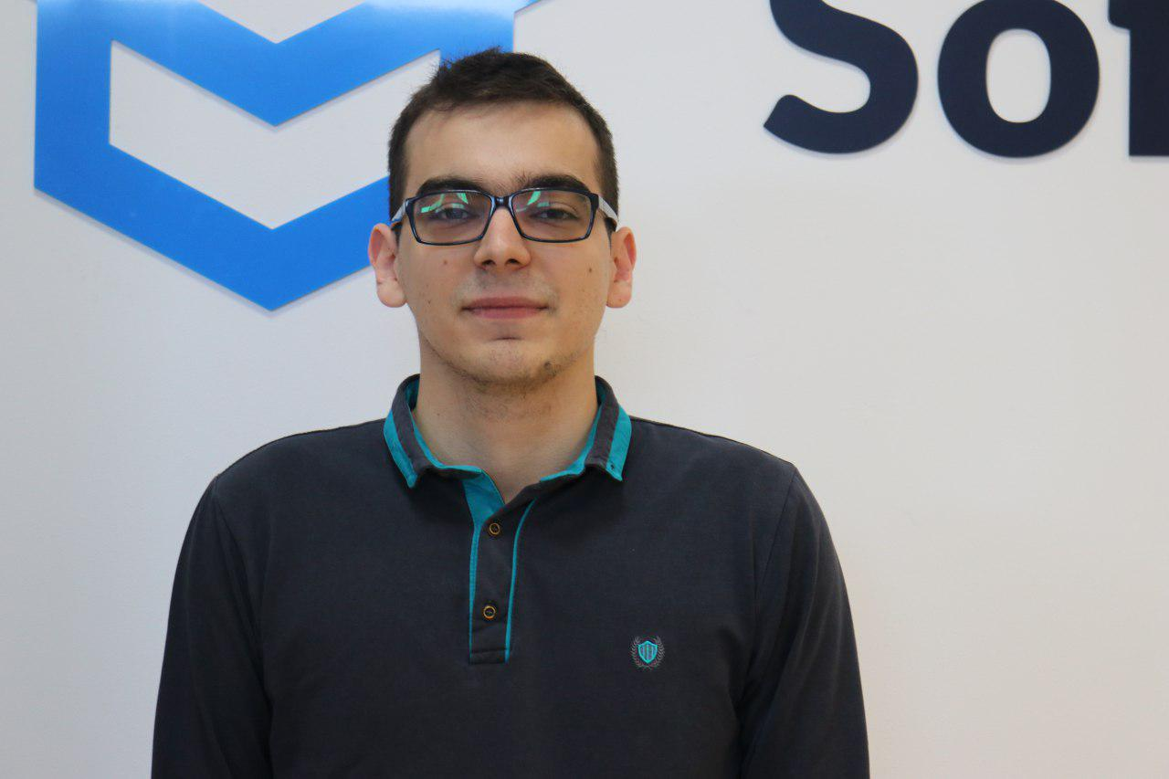
Kiril Kirilov
Team Lead @ SoftUni
Worked as a Front-End Developer
Passionate about .NET, JavaScript, Angular
Currently studying Math & Informatics at Sofia University (FMI)
Contacts:
k.kirilov@softuni.bg

Slide 12

Antonia Atanasova
Passionate about Front-End Development
Program Lead JavaScript & Technical Trainer in SoftUni
Web Development Freelancer
Contacts:
a.atanasova@softuni.bg
http://antoniaat.com

Slide 13

Course Objectives
Course Details and Schedule

Slide 14
Targets of the course
The JavaScript Applications course provides
Technologies for creating Single Page Apps (SPA)
Consuming RESTful Services (REST) with AJAX
Creating UI templates
Common JS programming patterns and routing

Slide 15

Exam
Structure: SPA (Single Page Application) for 4 hours
Implement CRUD operations + login / register / logout
Use AJAX and REST + cloud-based back-end (Kinvey)
Optionally:
Use templates for rendering
Use MVC architecture + routing
https://judge.softuni.bg/Contests/Practice/Index/1656#0

Slide 16
Theoretical Exam
20 questions for 30 minutes
Multiple-choice with 1 correct answer
English
Automated quiz system
Available online the day before the practical exam
You can submit your answers just one time

Slide 17



Scoring System for the Course
Theoretical Exam 5%
PracticalExam 90%
Presence in class 5%
Evaluation
Homework 5 %

Slide 18

Course Organization

Slide 19

Evaluation Criteria
Mandatory
Final exam - 90%
Theoretical exam - 5%
Exercises/Homework - 5%
Bonuses:
Presence in class - 5% bonus (onsite students only)

Slide 20
https://softuni.bg/courses/js-applications

Slide 21




Trainings @ Software University (SoftUni)
Software University – High-Quality Education and Employment Opportunities
softuni.bg
Software University Foundation
http://softuni.foundation/
Software University @ Facebook
facebook.com/SoftwareUniversity
Software University Forums
forum.softuni.bg

Slide 22

License
This course (slides, examples, demos, videos, homework, etc.) is licensed under the "Creative Commons Attribution-NonCommercial-ShareAlike 4.0 International" license

